Slide 1
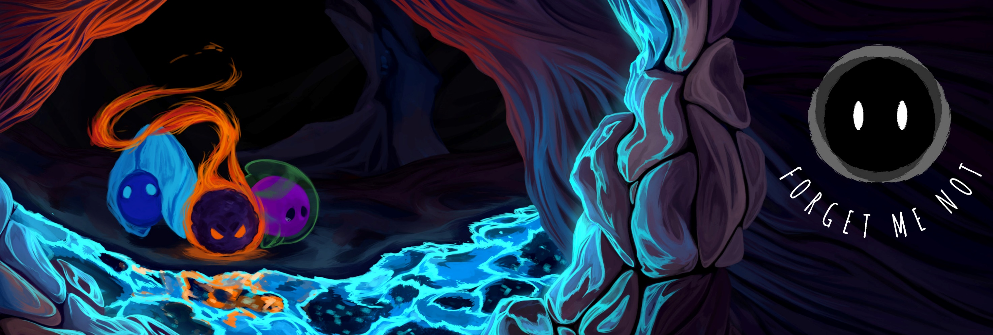
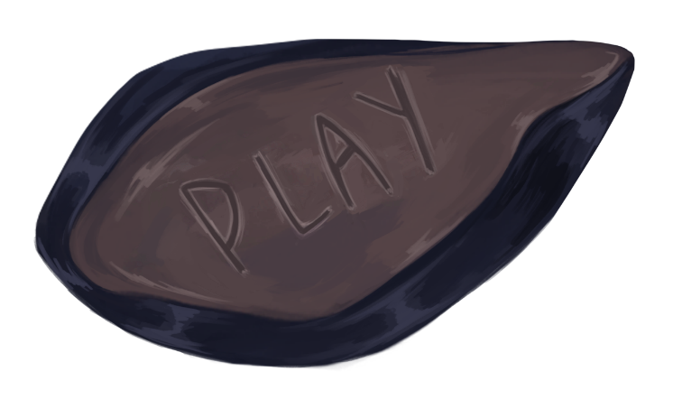
First year collaborative project (BA) – Ludic games
BY DANIEL BARACOTTI, FREDERYK SPERLING, Alba Pläp Golfe, Sebastian gerena and tamina Brunke

Slide 2
CORE CONCEPT
Single player
PUZZle-PlaTformer
Negative emotions as character
Combine Emotions and abilities
Notes:
Aspects of the game: Basic information and refresh memories

Slide 3
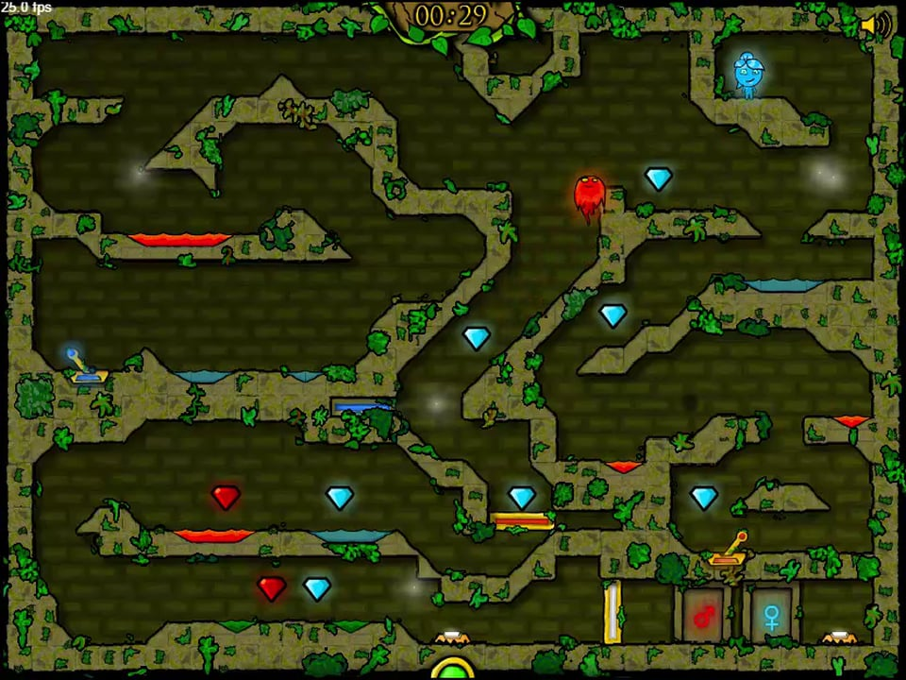
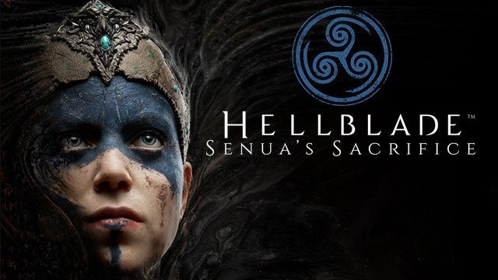
Inspiration
Fireboy and watergirl
Hellblade: senua’s sacrifice
Notes:
Inspiration/ Comparable successfull titles

Slide 4
Target Group
15-25 years old
Casual Gamers The game as a possibility to relief stress and have an enjoyable experience without much expertise
Pc gamer
Notes:
Aspects of the game: Target group

Slide 5
„Selling points“
Broad abilities allow for lots of experimentation, Creative and unconventional solutions are encouraged
Over 20 fun and challenging levels, with ranging difficulties
Cute and adorable aesthetics
Set around a unique theme
Notes:
Selling Points (pls change the title to something better QQ):
-Unique theme as in mental stuff, there are not many games out there with that topic

Slide 6
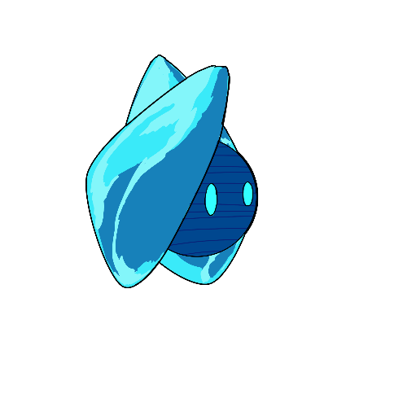
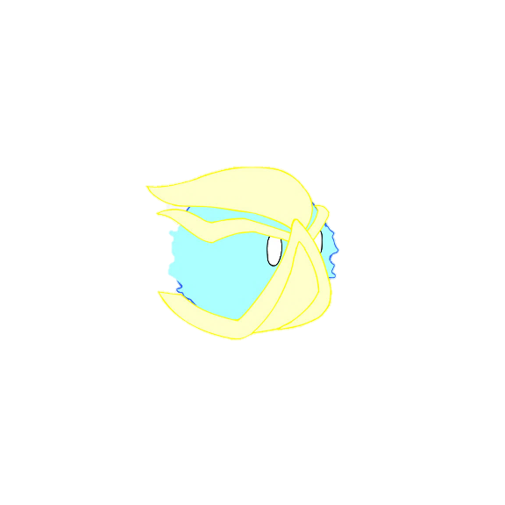
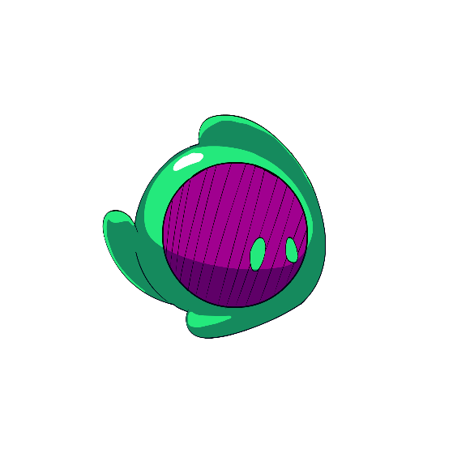
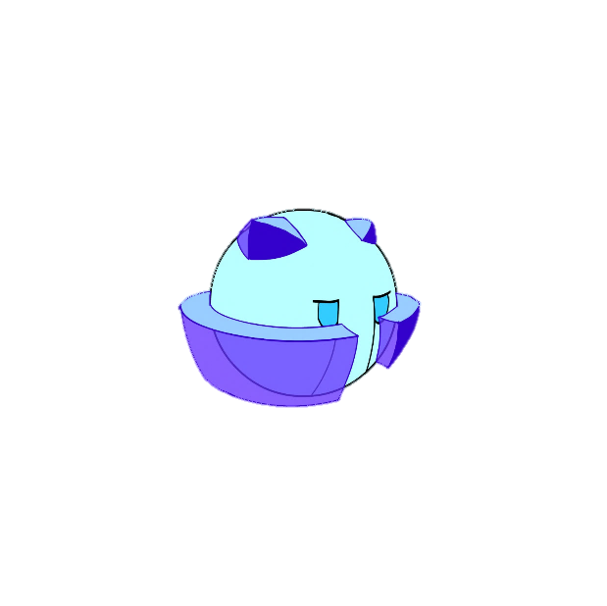
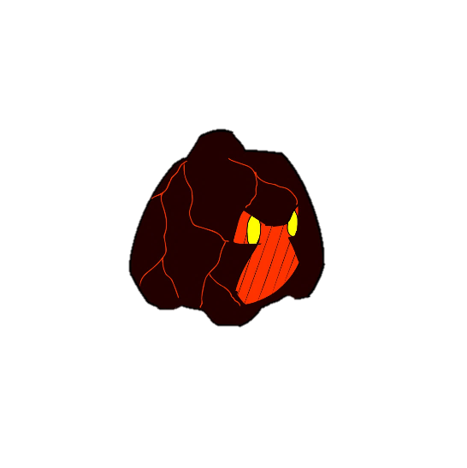

game direction
Mental health
PUZZle-PlaTformer
Negative emotions as character
Notes:
Aspects of the game: Game Direction (mental health as a main theme) -explains the choice for the puzzle platformer (They main characters are „lost“, the mind is a huge puzzle, „find their way“, etc.)
-explains the choice for our characters, negative emotions and traits, influenced our character design.

Slide 7
Anxiety
stress
apathy
Rage
depression
frustration
Notes:
Aspects of the game: Game Direction (and reason why our game fits the theme „unity“ and „allies“ -„balanced state of mind“
– unity
- work together, allies

Slide 8
Core Mechanic
Ability
Meeting
Controllable
Notes:
Aspects of the game: Main Loop

Slide 9


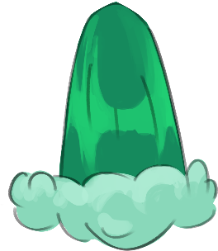
Individual abilities
Rampage
A forward dash making rage’s flames burn stronger
run through breakable obstacles
light flammable objects
Activate explosives
Cold Feet
Makes Anxiety freeze in place.
immovable
Repel projectiles
invulnerable
Can be used as a platform
Crybaby
Makes Depression cry a huge amount of tears.
fill up containers
put out fires
raise water levels
Tear jet-pack
Notes:
VIDEOO
Aspects of the Game: Characters and Design/Art: Character Design
-character
-abilities
-intercations with interactibles
-intercations between them (Anxiey can stop rage, they have to meet up and calm each other down)

Slide 10
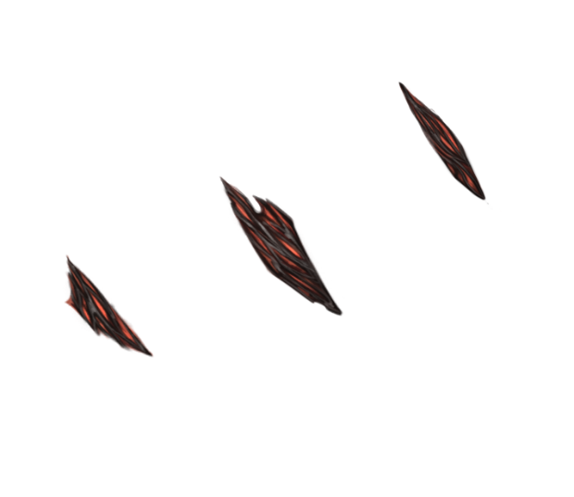

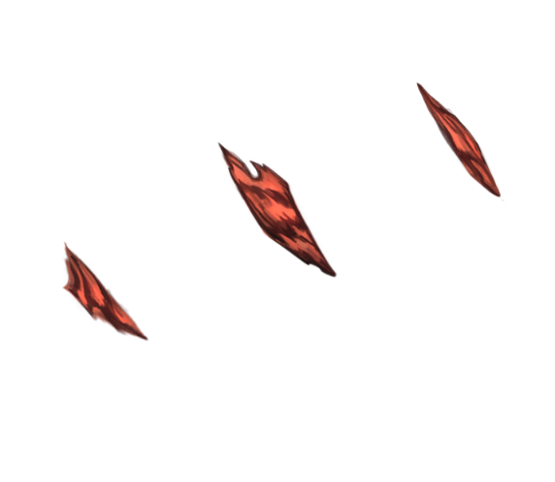
combined abilities
Eruption (Rage&Dep.):
cries magma tears, that harden immediately.
Can be used to create paths
Frozen Outrage (Rage&Anx.):
runs very fast and becomes invulnerable
Can run over hazardous terrain
Can run through enemies to defeat them
Icey Tears (Dep.& Anx.):
can shoot controllable frozen tears.
Can defeat enemies from a distance
Can activate otherwise unreachable mechanisms
Notes:
VIDEOO
Aspects of the Game: Characters and Design/Art: Character Design

Slide 11
controls
q
e
f
W
switch
ability
combine
a
s
d
r
Esc
move
restart
menu
Notes:
Aspects of the game: Controls

Slide 12
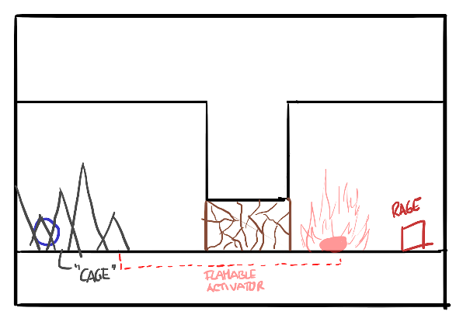
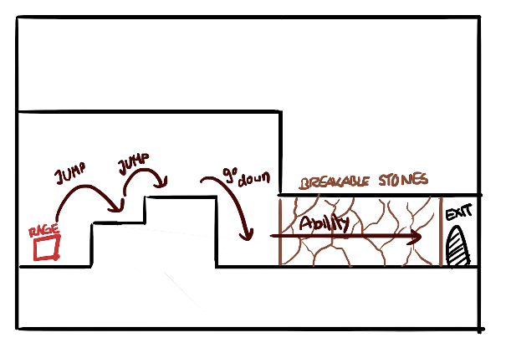
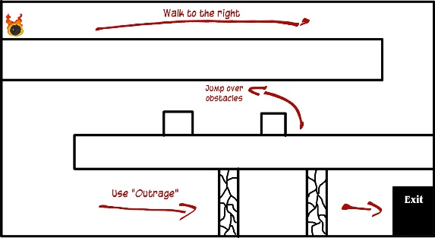
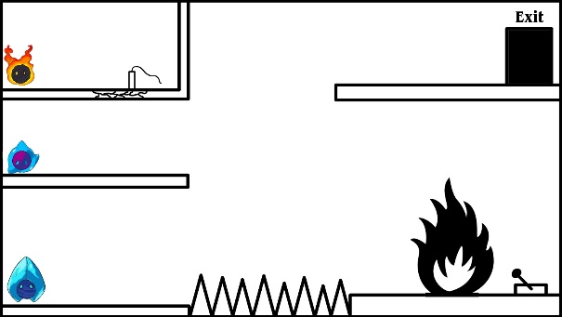
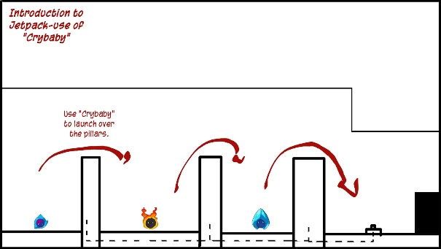
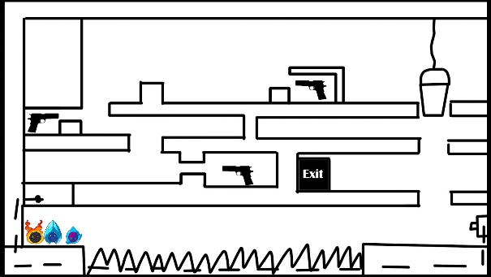
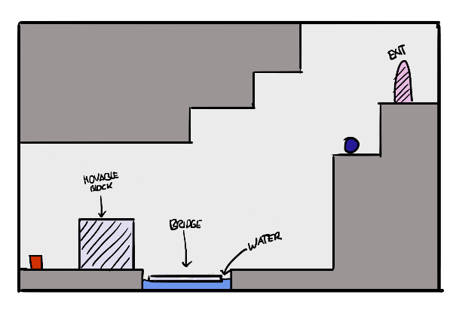
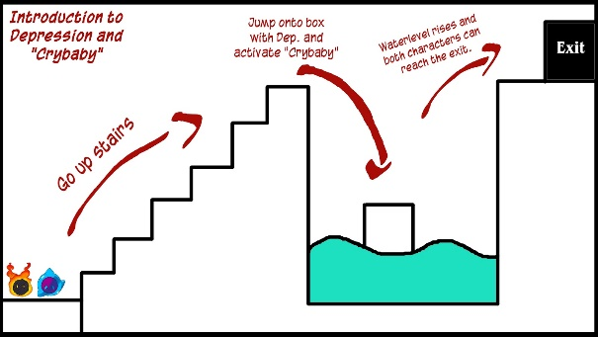
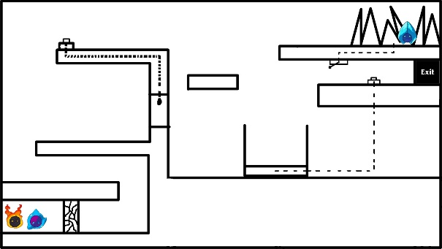
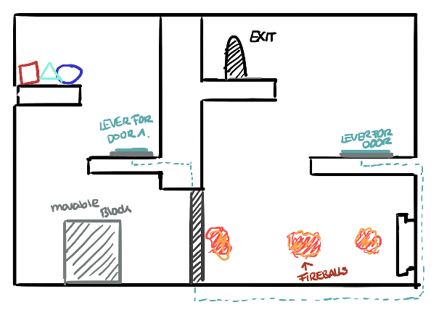
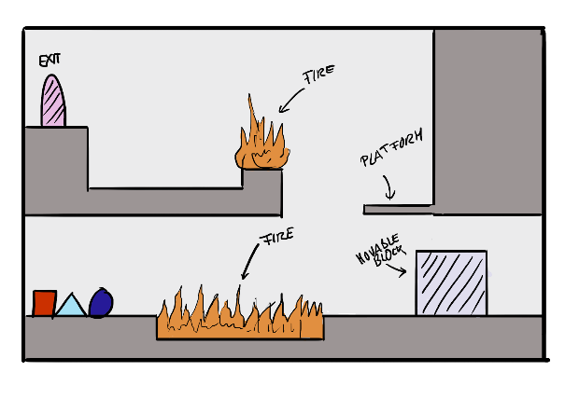
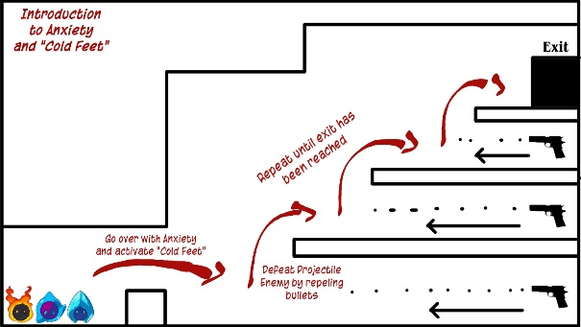
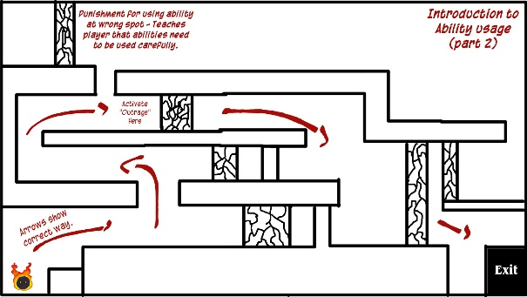
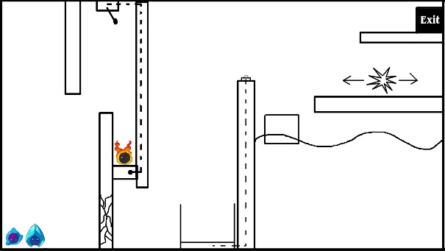
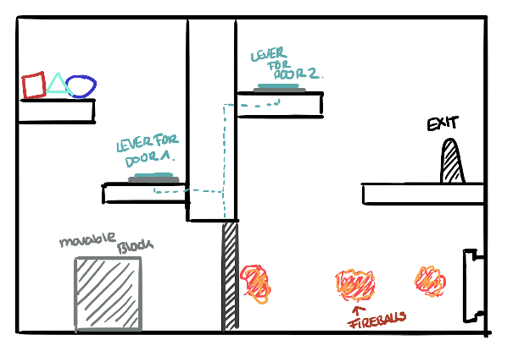
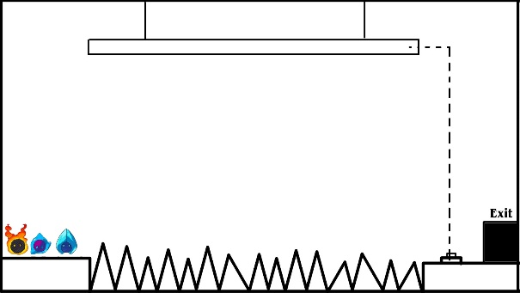
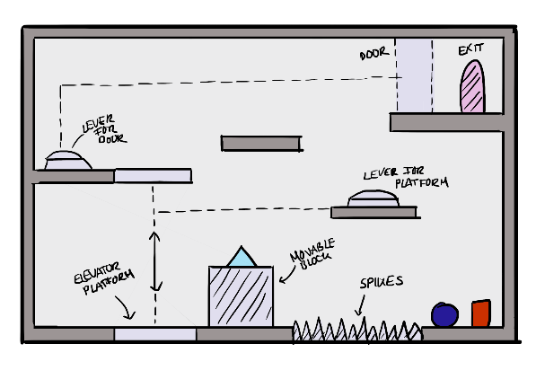
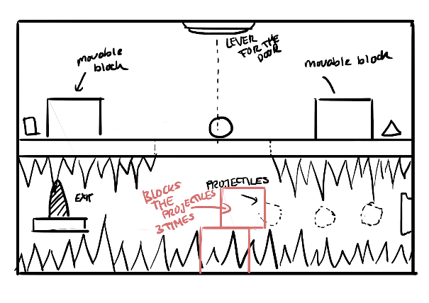
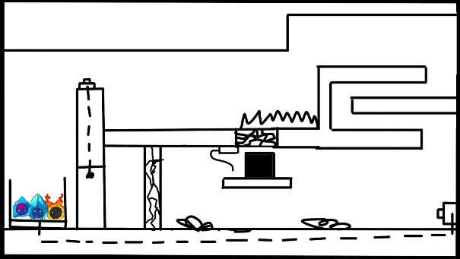
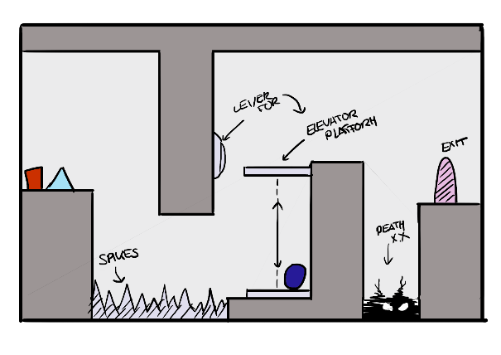
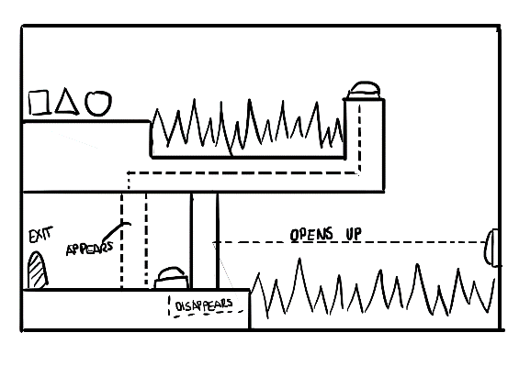
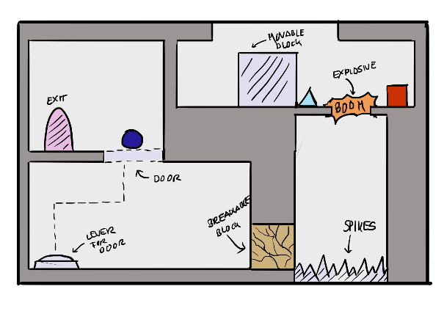
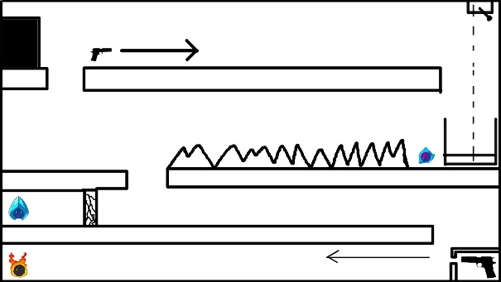
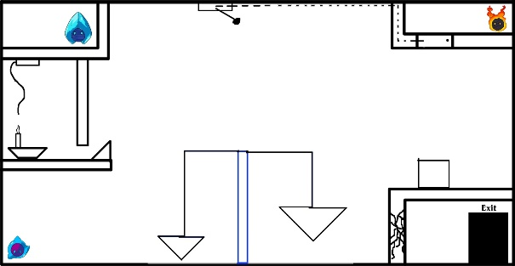
Levels
Notes:
Design: Level Design Development:
-scribbles
-visualization

Slide 13
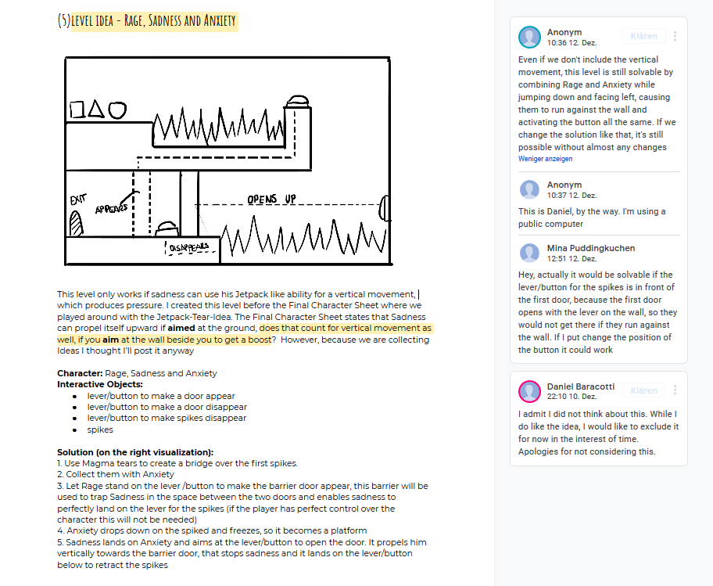
Levels
Notes:
Design: Level Design Development:
-different approaches (interactibles, abillities, etc.)
-Scribble and solution, sometimes some extra imformation and a little discussion on the side

Slide 14
Level Progression
Picture of the level selection
Notes:
VIDEOOF MENU

Slide 15
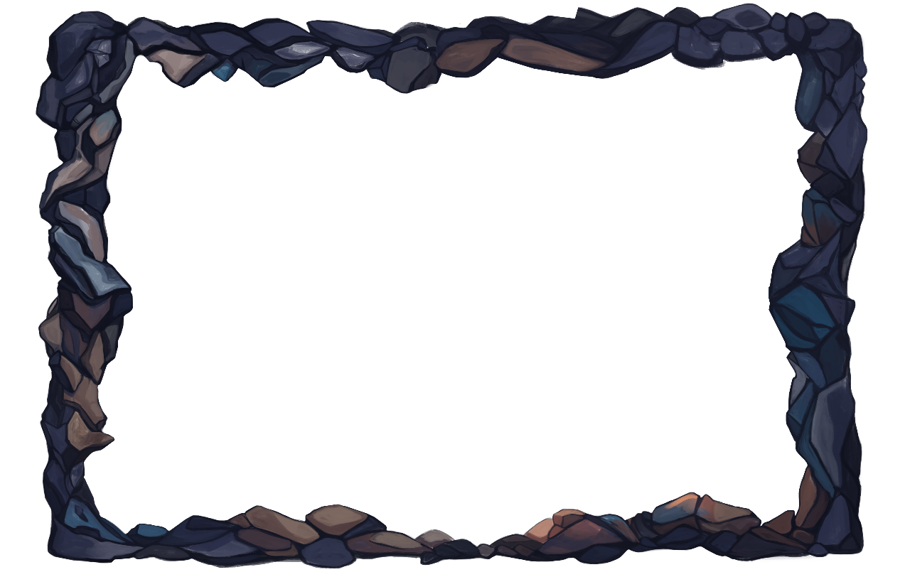
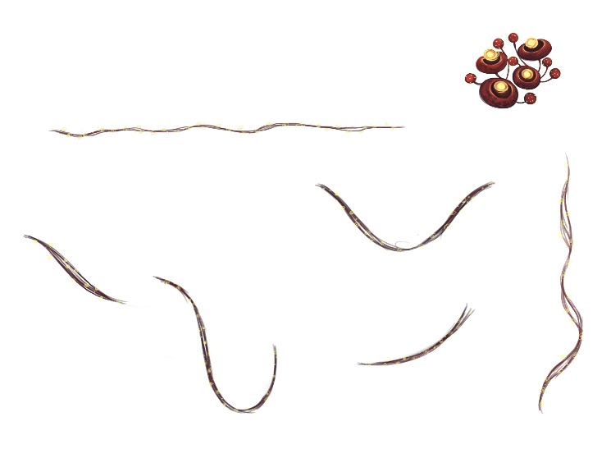
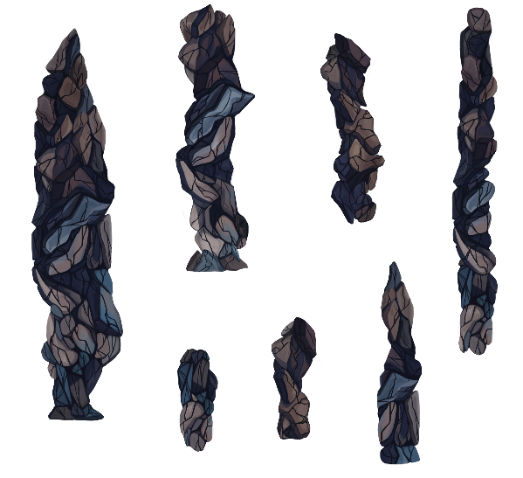
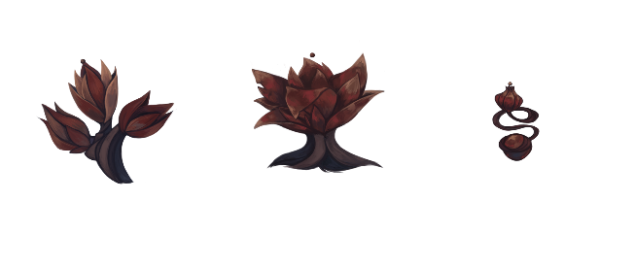
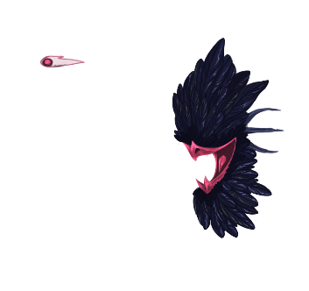

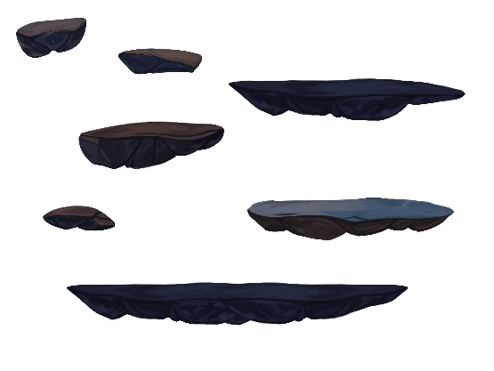
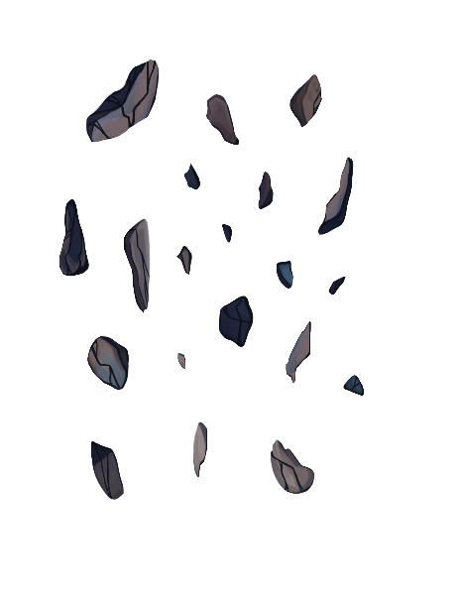
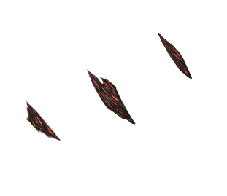
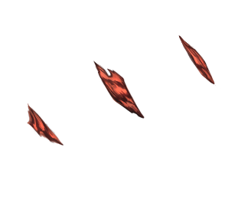
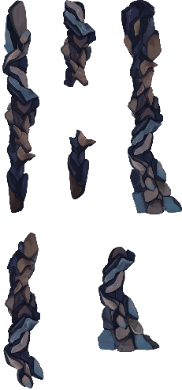
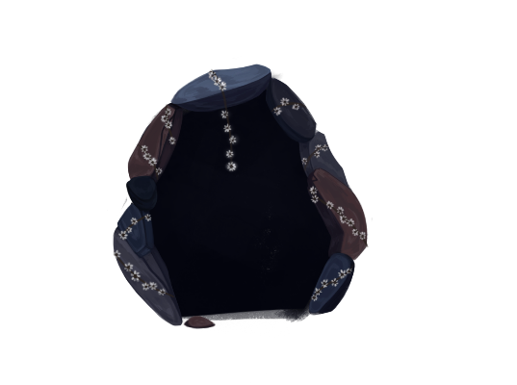
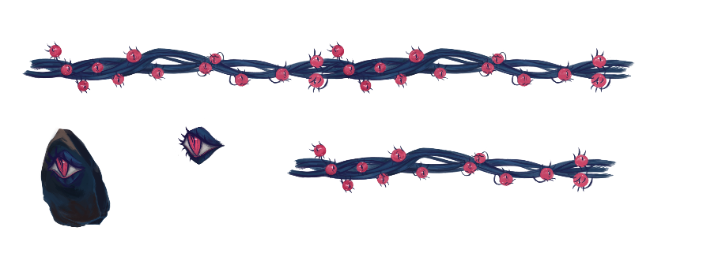
assets
Notes:
Design/Art: Development of the Assets
-> mention the level builder and the assets
-> transition to Art and the design of the assets

Slide 16
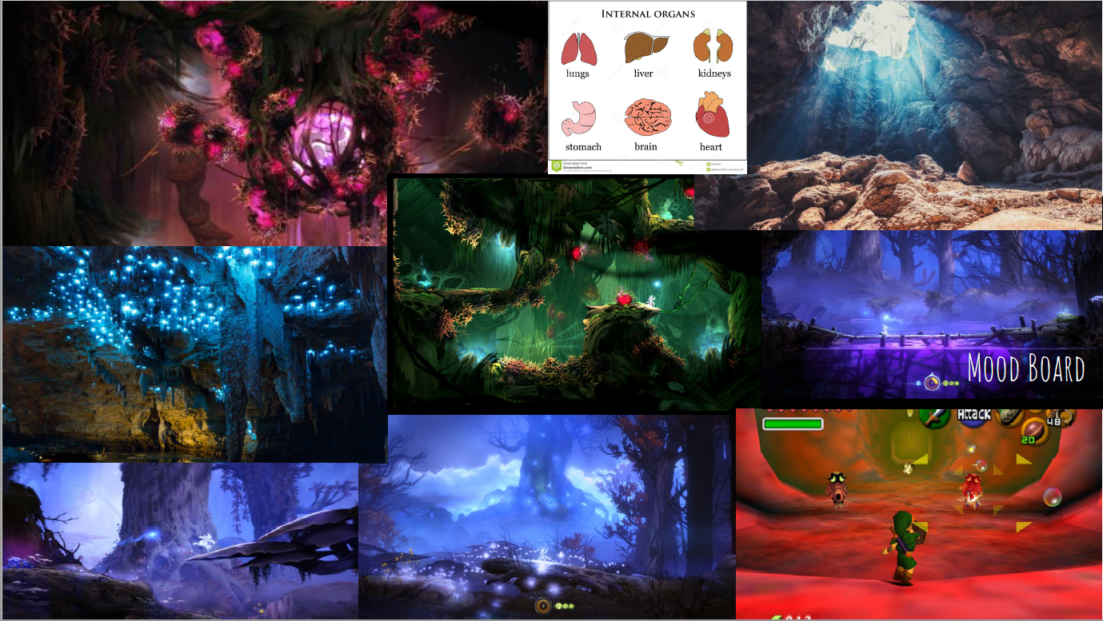
Notes:
Art: Inspiration for the „cave“ theme(development)

Slide 17










Logo
Notes:
Aspects of the game: Logo Design (I guess it‘s not that important for the presentation)

Slide 18


CHARACTER
Notes:
Art: Character Design development
- Talk about the thoughts behind the visual character design

Slide 19
Notes:
Art: Character Design development ( 1-5 high quality in-game or concept artworks)
VIDEOO OF CLOSEUPOF CHARACTERS

Slide 20

Notes:
Aspects of the game: Main Menu, splashart and development(Art: 1-5 high quality in-game or concept artworks)
- Maybe add more wip stages of the splashart.

Slide 21

In-game
Notes:
Art: 1-5 high quality in-game or concept artworks

Slide 22
Unity Project Structure
Character > separate into character baseclass and specific subclasses
Level builder > scene with integrated design manager > add interactibles > drag n drop
Interactables > prefabs w/ scripts and sprites, interactable base class
> Enemies (monsters, spikes, projectiles)
> Projectiles (tears, enemy bullets)
> Platforms (platforms, pillars)
Notes:
VIDEO
Programming: (slides from the old presentation)

Slide 23

level builder > moves all objects to interactables manager at runtime
Notes:
Programming: (slides from the old presentation)

Slide 24

level builder > scene with integrated design manager > add interactibles > drag n drop
Notes:
Programming: (slides from the old presentation)

Slide 25





Artist Provide Character and Background sprites
Designer Create level ideas and build levels
Programmer implements the scripts
Development
Artists
Designers
Programmer
Character design &
animation
Game mechanics
mechanics and asset implementation
puzzles
Environment & asset design
Level design
Level builder
Notes:
FMOD LOGO
Development PLAN: How we worked together (reflect on the project plan) -Communication: What‘s App group, discord meetings and meetings at CGL
-Programs for „data exchange“: Google Drive, GitHub (and Spaces, I guess…..)
-“Game Development program“: Unity

Slide 26
TRAILER

Slide 27

Daniel Baracotti (Level Design/ Mechanic Design/Documentation) : daniel.baracotti@web.de
Tamina Brunke (Level Design/Framework): taminabrunke@outlook.com
Sebastian Gerena (Character Design/Illustrations): belmontx21@hotmail.com
Alba Plaep Golfe (Project Lead/Environment Design/Illustrations): alba.plaep@gmx.de
Frederyk Sperling(Programming/Sound Design): mail@frederyk.de
Moon flower bold by Denise bentulan
A b c d e f g h I j k l m n o p Q r s t u v w x y z
FORGET ME NOT…

Slide 28






interactables
Fuses
Connect interactable objects
Eye switch
can activate or deactivate interactables like doors or moving platforms
Explosive mushrooms
explode when set on fire
Shooting flower
shoots harmful projectiles
Fire flower
Friendly helper emitting flames
spikes
You touch them – you die.
Notes:
Aspects of the Games: Interactibles (We could just mention them during the level design development and assets.)
- Examples of interactibles

